Slide 1

Denial of Service (DoS)
PREPARED BY:
KUMAIL ZAIDI
Cyber Lab Final Project

Slide 2
Denial of Service (DoS)
What is DoS & DDoS
Methods Attacks
Problems & Cost
Types of Attacks
Three Way Handshake
Way of infected
Hacking Steps
Avoid problems
Defenses
Example

Slide 3
A DoS (Denial of Service)
Attack in which the primary goal is to deny the victim(s) access to a particular resource.
A DoS (Denial of Service) attack aims at preventing, for legitimate users, authorized access to a system resource or the delaying of system operations and functions.
Is an attempt to make a computer resource unavailable to its intended users. Typically, the targets are high- profile web servers where the attack is aiming to cause the hosted web pages to be unavailable on the Internet.

Slide 4
What is DDoS?
Attack uses multiple machines operating in concert to attack a network or site, and these attacks cause so much extra network traffic that it is difficult for legitimate traffic to reach your site while blocking the forged attacking packets.
Attacker may use your computer to attack another computer, by taking advantage of security vulnerabilities or weaknesses, an attacker could take control of your computer. He or she could then force your computer to send huge amounts of data to a web site or send spam to particular email addresses.
The attack is "distributed" because the attacker is using multiple computers, including yours, to launch the denial-of-service attack.

Slide 5
Methods of Attacks
A "denial-of-service" attack is characterized by an explicit attempt attackers to prevent legitimate users of a service from using that service. Examples include:
Attempts to "flood" a network, thereby preventing legitimate network traffic.
Attempt to disrupt a server by sending more requests than it can possibly handle, thereby preventing access to a service.
Attempts to prevent a particular individual from accessing a service.

Slide 6
Scope of the problem
A denial-of-service attack can effectively shut down a web site for hours or even days.
DOS attacks cost significant losses
On February 2000, several serious DDoS attacks targeted some of the largest Internet web sites, including Yahoo, Buy.com, Amazon, CNN and eBay.

Slide 7
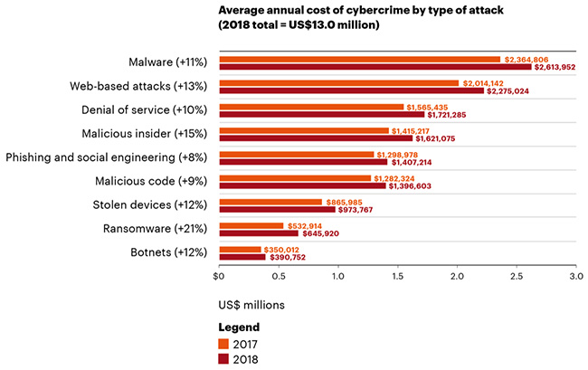
Cost of DoS attacks for victim organizations
Denial of Service is currently one of the most expensive computer crime for victim organizations:

Slide 8
Types of Attacks
SYN Flood
Smurf Attack (ICMP Flood)
LAND Attack
UDB Flood
Trinoo
Tribal Flood Network (TFN &TFN2K)
Stacheldraht

Slide 9
TCP Three Way Handshake
When a computer wants to make a TCP/IP connection (the most common internet connection) to another computer, usually a server, an exchange of TCP/SYN and TCP/ACK packets of information occur.
The computer requesting the connection, usually the client's or user's computer, sends a TCP/SYN packet which asks the server if it can connect.
If the server will allow connections, it sends a TCP/SYN-ACK packet back to the client to say "Yes, you may connect" and reserves a space for the connection, waiting for the client to respond with a TCP/ACK packet detailing the specifics of its connection.

Slide 10
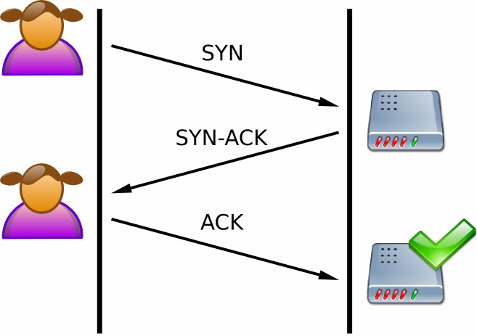
TCP Three Way handshake
A normal connection between a user and a server. The three-way handshake is correctly performed.

Slide 11
SYN Flood
Sends a flood of TCP/SYN packets, often with a forged sender address. Each of these packets are handled like a connection request, causing the server to spawn a half-open connection, by sending back a TCP/SYN-ACK packet, and waiting for an TCP/ACK packet in response from the sender address. However, because the sender address is forged, the response never comes. These half-open connections consume resources on the server and limit the number of connections the server is able to make, reducing the server's ability to respond to legitimate requests until after the attack ends.
In a SYN flood the address of the client is often forged so that when the server sends the go-ahead back to the client, the message is never received because the client either doesn't exist or wasn't expecting the packet and subsequently ignores it. This leaves the server with a dead connection, reserved for a client that will never respond. Usually this is done to one server many times in order to reserve all the connections for unresolved clients, which keeps legitimate clients from making connections.

Slide 12
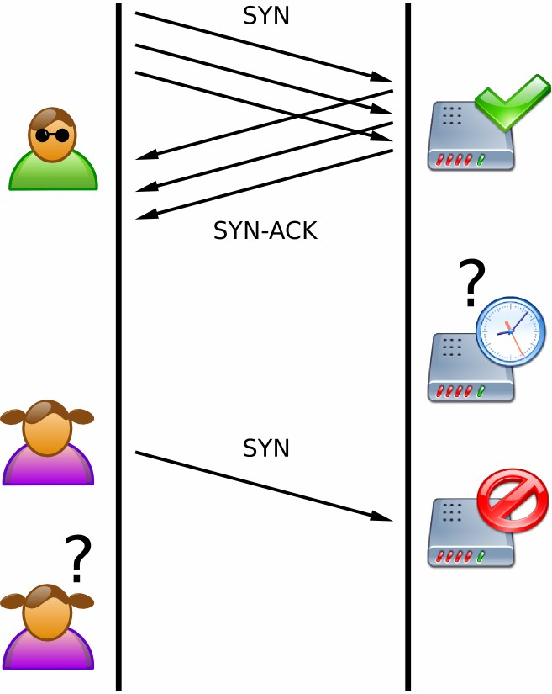
SYN Flood
The attacker sends several packets but does not send the "ACK" back to the server. The connections are hence half-opened and eat the server resources. A legitimate user, tries to connect but the server refuses to open a connection resulting in a denial of service.

Slide 13
Example
The classic example is that of a party. Only 50 people can be invited to a party, and invitations are available on a first-come first-serve basis. Fifty people send letters to request invitations, but the letters have false return addresses. The invitations are mailed to the return addresses of the request letters.
Unfortunately all the return addresses provided were fake, so nobody receives the invitations. Now, when someone actually wants to come to the party (view the website), there are no invitations left because all the invitations (connections) have been reserved for those 50 people.

Slide 14
Smurf Attack (ICMP)
Technique that takes advantage of the ICMP (Internet Control Message Protocol).
Smurf is installed on a computer using a stolen account, and then continuously "pings" one or more networks of computers using a forged source address.
It relies on mis-configured network devices that allow packets to be sent to all computer hosts on a particular network via the broadcast address of the network, rather than a specific machine. The network then serves as a smurf amplifier. In such an attack, the perpetrators will send large numbers of IP packets with the source address faked to appear to be the address of the victim.

Slide 15











Zombie Network
Attacker
Zombie (Agent)
Victim

Slide 16
How to avoid DDOS?
Attack surface reduction: Limiting attack surface exposure can help minimize the effect of a DDoS attack. Several methods for reducing this exposure include restricting traffic to specific locations, implementing a load balancer, and blocking communication from outdated or unused ports, protocols, and applications.
Anycast network diffusion: An Anycast network helps increase the surface area of an organization’s network, so that it can more easily absorb volumetric traffic spikes (and prevent outages) by dispersing traffic across multiple distributed servers.

Slide 17
Defenses
Disable and filter out echo services
Disable and filter out all unused UDP services.
Good practice is to block all UDP ports below 900 (excluding some specific ports like DNS)
Network administrators should log all information on packets that are dropped
If you are providing external UDP services, monitor them for signs of misuse

Slide 18
Defenses
Routers, machines, and all other Internet accessible equipment should be periodically checked to verify that all security patches have been installed.
System should be checked periodically for presence of malicious software (Trojan horses, viruses, worms, root- kits, back doors, etc.).

Slide 19
Famous Example
A 15-year-old script kiddie called Mafiaboy was arrested in an upper class neighborhood in Montreal in 2000. Using downloaded DoS attacks, he struck famous websites such as Yahoo, Dell, Inc., eBay, and CNN, causing roughly 1.7 billion dollars worth of damage. He pled guilty to 55 criminal charges and served 8 months in a youth detention center.
Jeffrey Lee Parson was an 18-year-old high school student from Minnesota responsible for using the B Variant of the infamous Blaster worm. The program was part of a DoS attack against computers using the Microsoft Windows operating system. The attack took the form of a SYN flood which caused only minimal damage. He was sentenced to 18 months in prison in 2005.

Slide 20
THANK YOU!!

